Slide 1
Metabolomic Analysis of Down Syndrome Fibroblasts
University of Fribourg
Csaba Szabo, PhD
URFI-01-19VW
March 13th, 2020
Aga Truax, PhD (Metabolon)

Slide 2
Study Overview
Study Objective
The goal of this study was to determine if metabolic alterations in fibroblasts derived from Down-syndrome patients can be restored by pharmacological inhibition of the CBS enzyme.
Study Design
Metabolon received 32 fibroblast cell pellet samples on January 20, 2020. Global metabolic profiles were determined from the experimental groups outlined in the table below.

Slide 3
Statistical Summary
From a total of 516 named biochemicals in human cell pellets

Slide 4
Data Display
Box Plot Legend
Metabolite Name
Scaled Intensity
Ctrl UT
DS UT
Ctrl AOAA
DS AOAA
Group

Slide 5
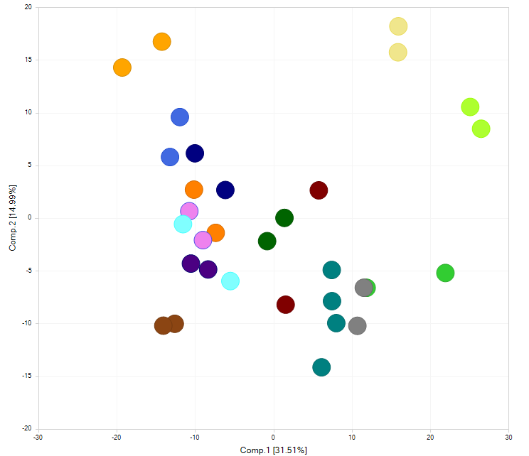
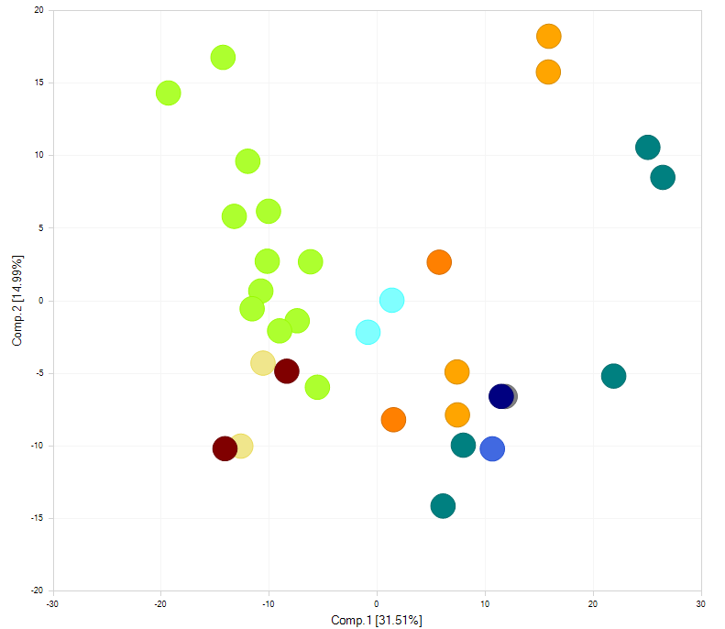
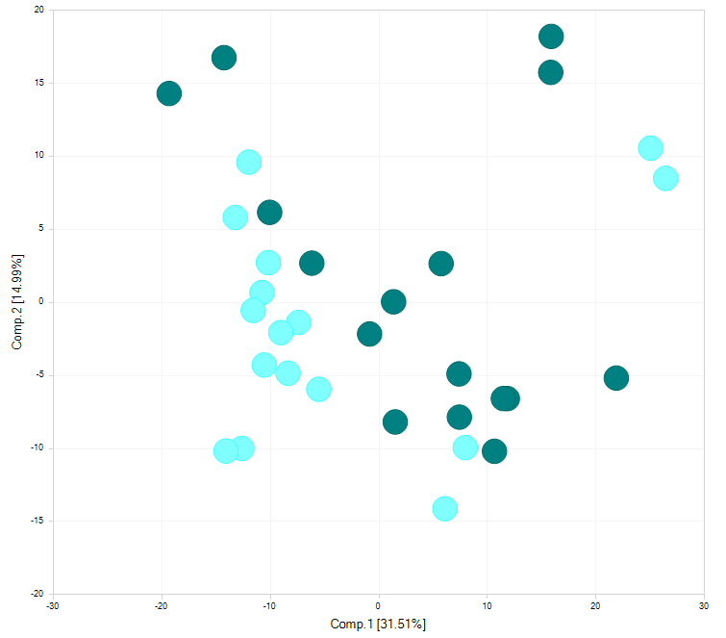
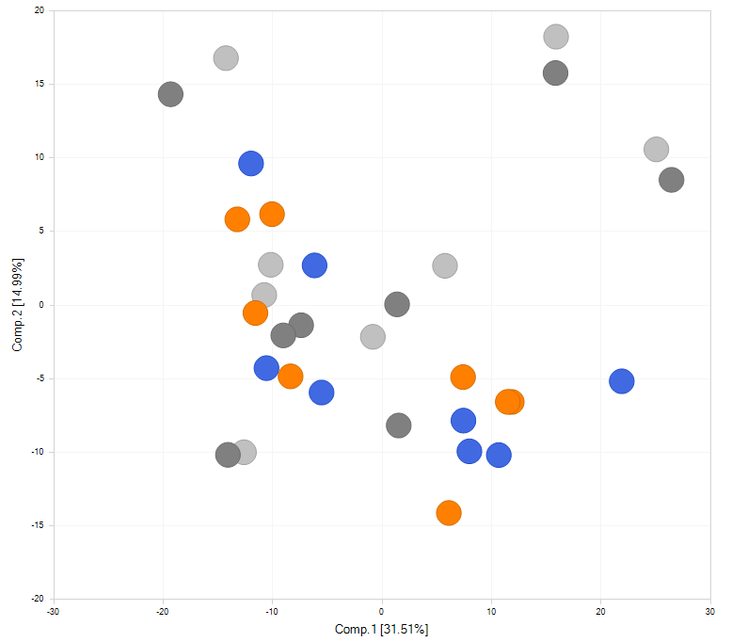
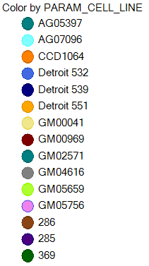
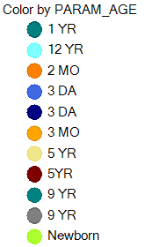

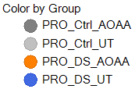
Principal Component Analysis (PCA)

Slide 6
Hierarchical Cluster Analysis (HCA)

Slide 7
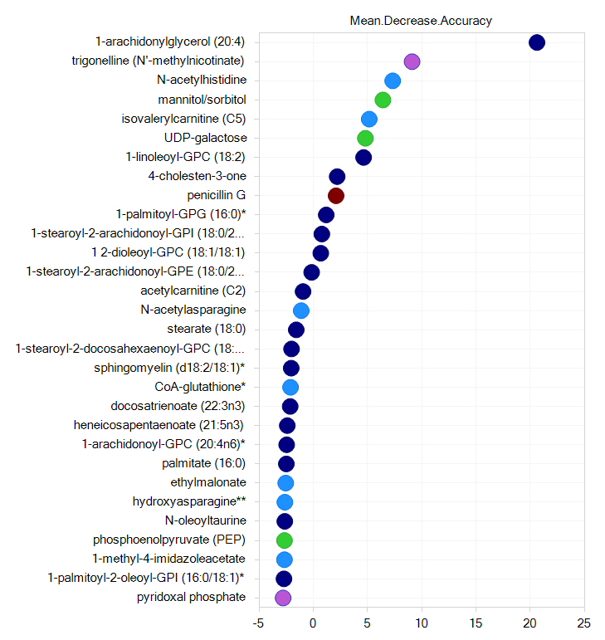
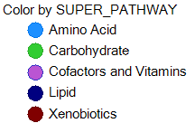
Random Forest Analysis-Treatment Effect (Matched Data set)
Increasing Importance to Group Separation
Biochemical Importance Plot
Random Forest Confusion Matrix
Predicted Groups
 | UT | AOAA | Class Error
UT | 9 | 7 | 0.437
AOAA | 9 | 7 | 0.562
Predictive accuracy = 50%
Actual Groups
Note that random segregation would give a predictive accuracy of 50%.
mean-decrease-accuracy

Slide 8
Random Forest Analysis-All Groups (Matched Data set)
Increasing Importance to Group Separation
Biochemical Importance Plot
Random Forest Confusion Matrix
Predicted Groups
 | DS UT | DS AOAA | CTRL UT | CTRL AOAA | Class Error
DS UT | 3 | 1 | 3 | 1 | 0.625
DS AOAA | 2 | 3 | 3 | 0 | 0.625
CTRL UT | 3 | 2 | 1 | 2 | 0.875
CTRL AOAA | 4 | 1 | 2 | 1 | 0.875
Predictive accuracy = 25%
Actual Groups
Note that random segregation would give a predictive accuracy of 25%.
mean-decrease-accuracy

Slide 9
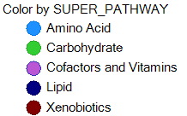
Random Forest Analysis-Status Effect (Matched Data set)
Increasing Importance to Group Separation
Biochemical Importance Plot
Random Forest Confusion Matrix
Predicted Groups
 | DS | Ctrl | Class Error
DS | 9 | 7 | 0.437
Ctrl | 9 | 7 | 0.562
Predictive accuracy = 50%
Actual Groups
Note that random segregation would give a predictive accuracy of 50%.
mean-decrease-accuracy

Slide 10
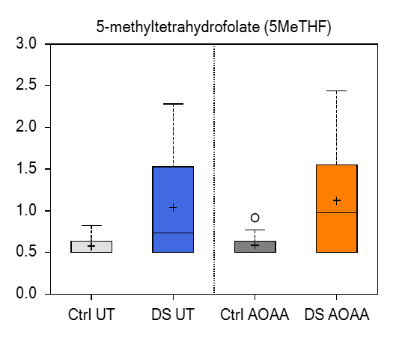
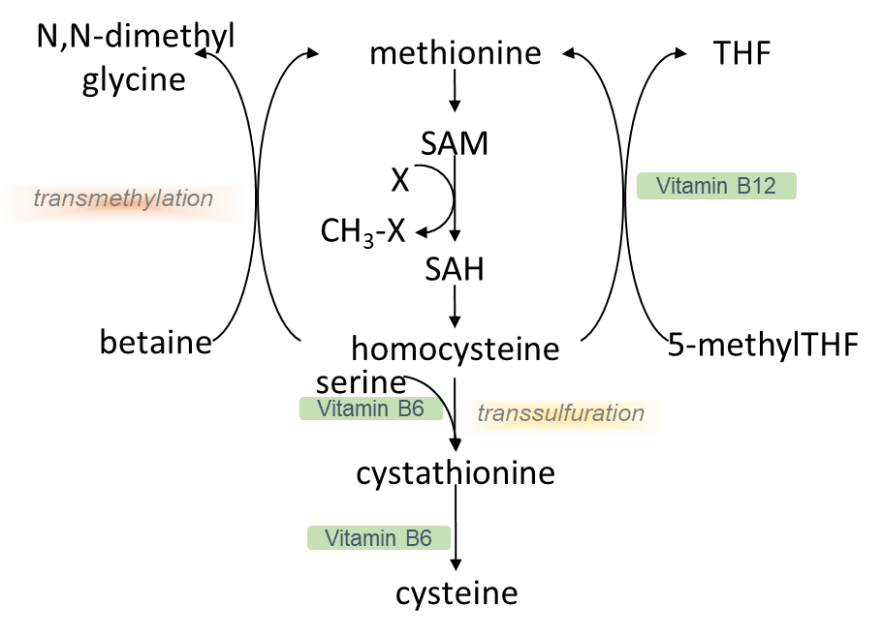
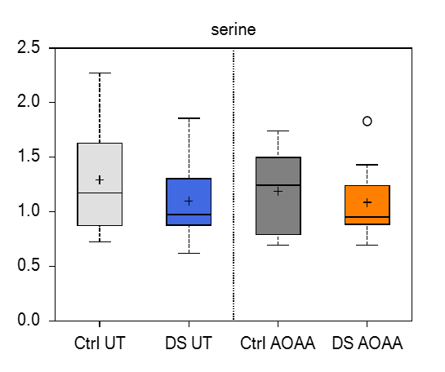
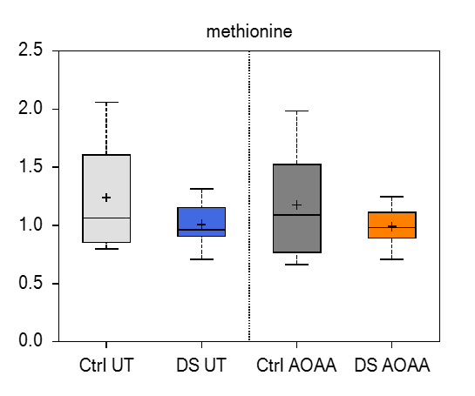
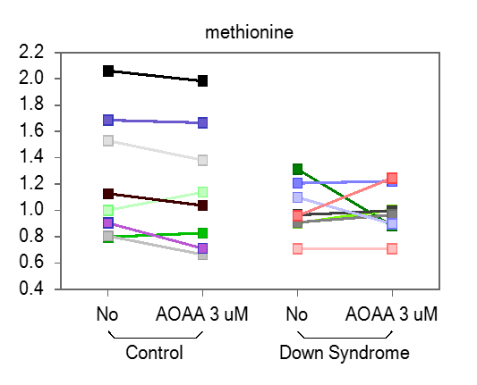
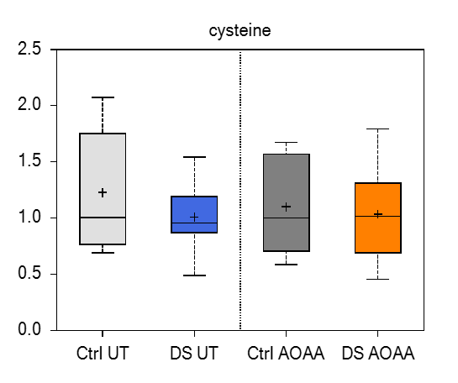
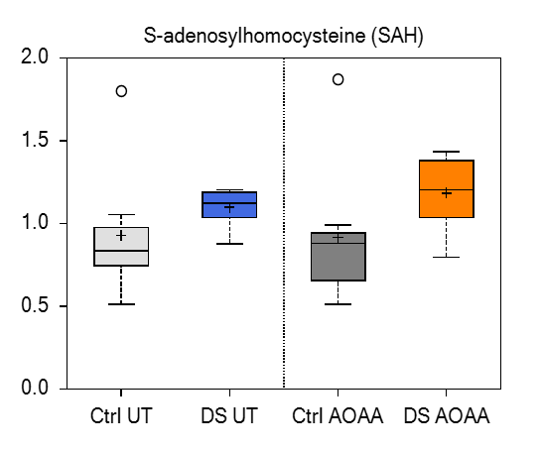
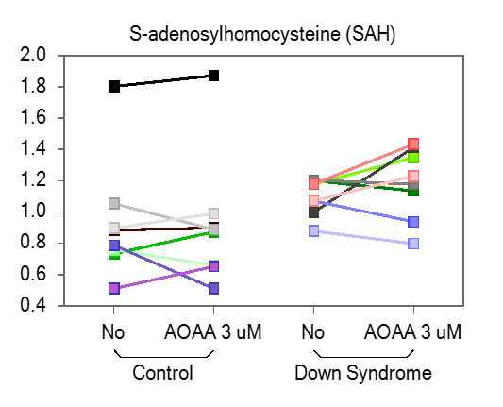
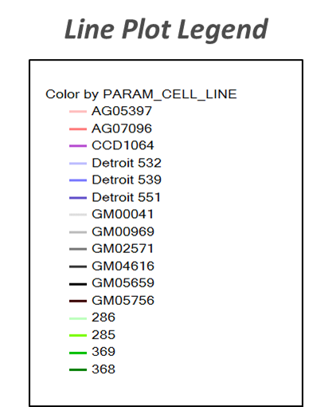
DS and treatment related changes in methionine/homocysteine pathway

Slide 11
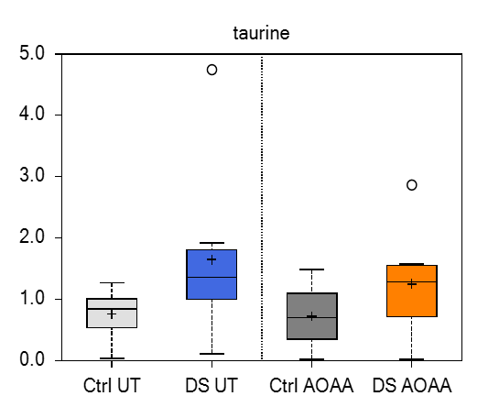
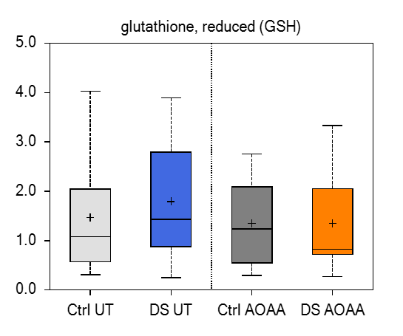
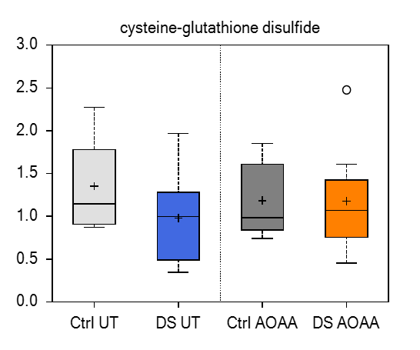
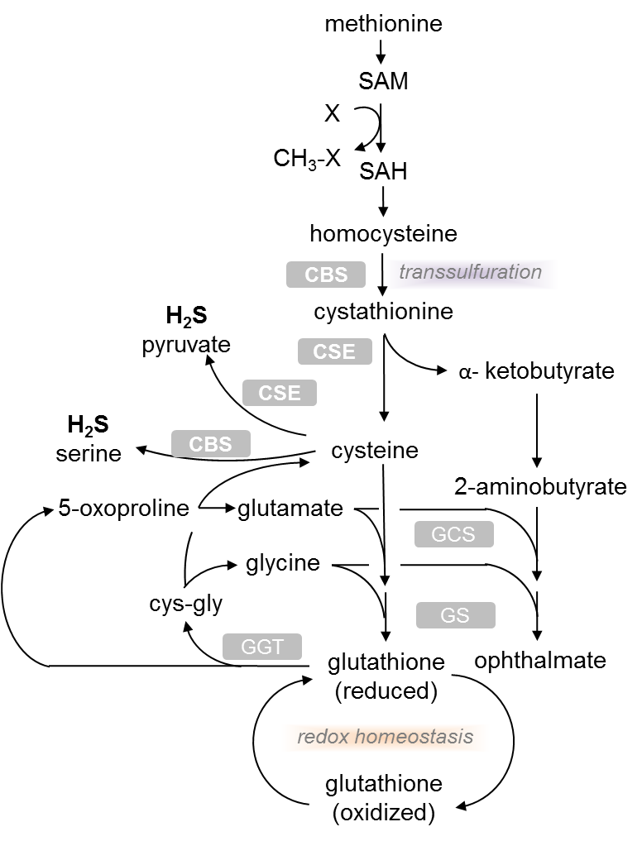
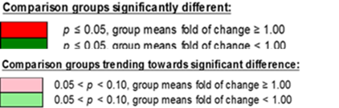
CBS inhibition in DS fibroblasts results in significant reduction of GSH

Slide 12
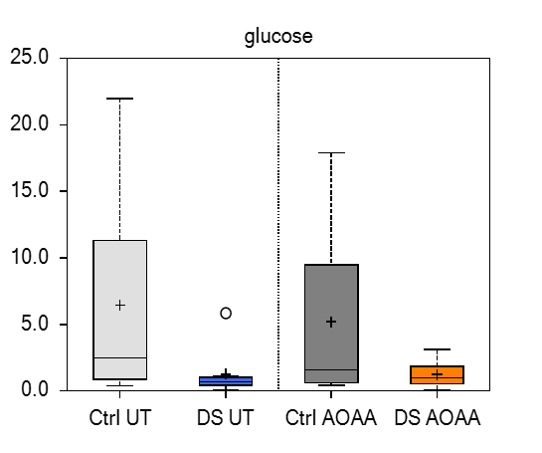
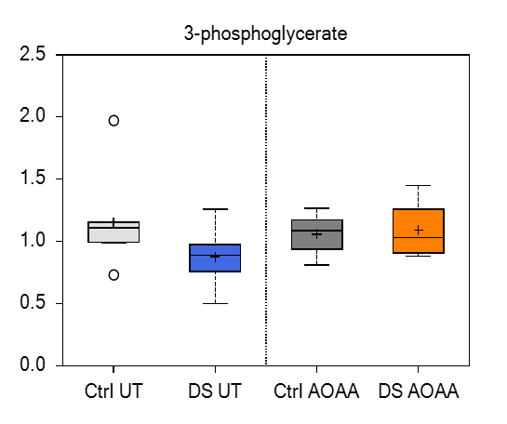
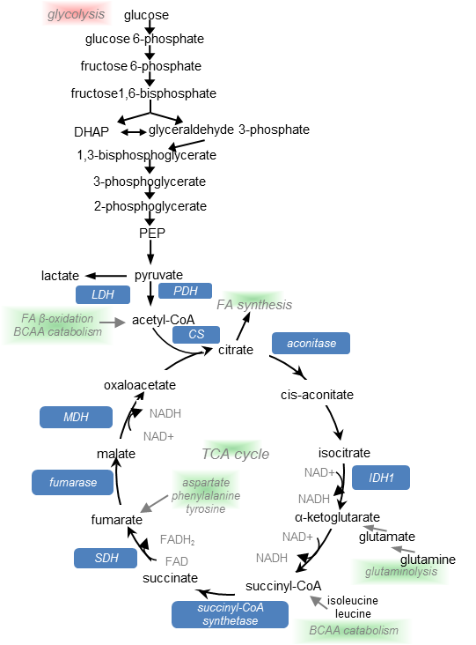
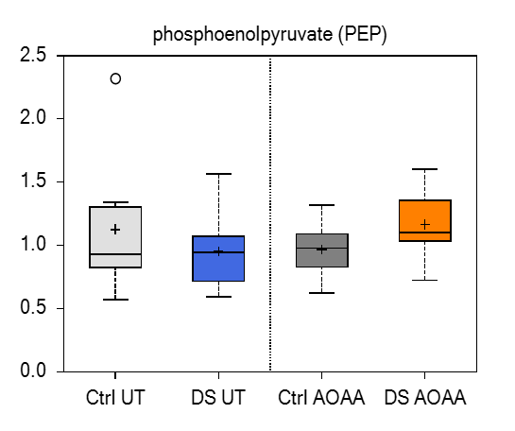
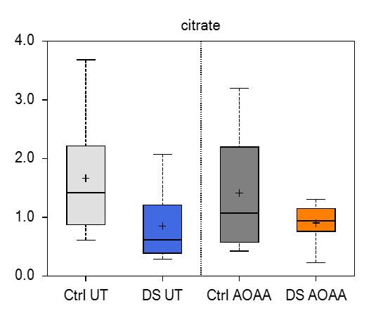
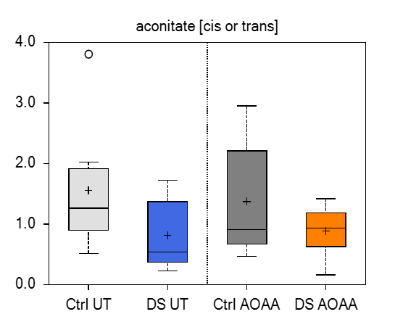
Alterations in Cellular Energetics - Glycolysis and TCA Cycle

Slide 13
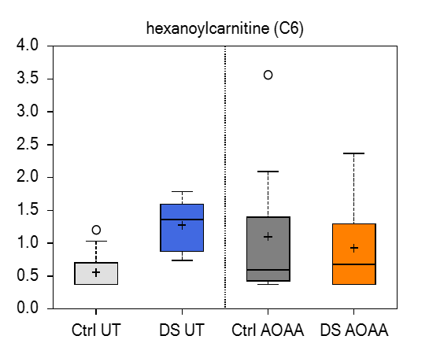
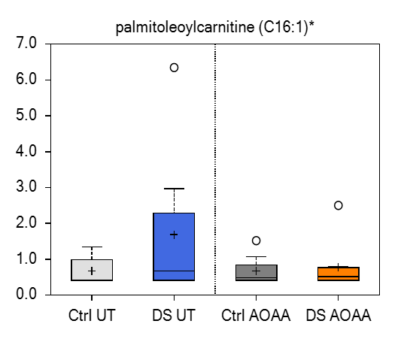
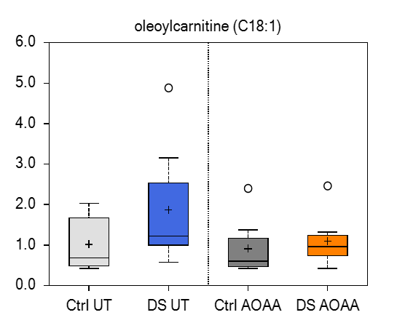
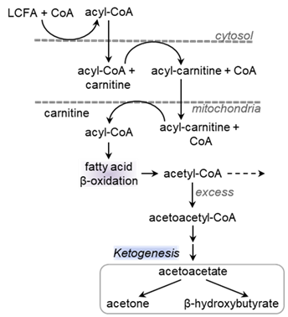
AOAA related changes in markers of beta oxidation amongst fibroblasts derived from DS subjects only

Slide 14

Treatment related changes in lipid metabolism

Slide 15
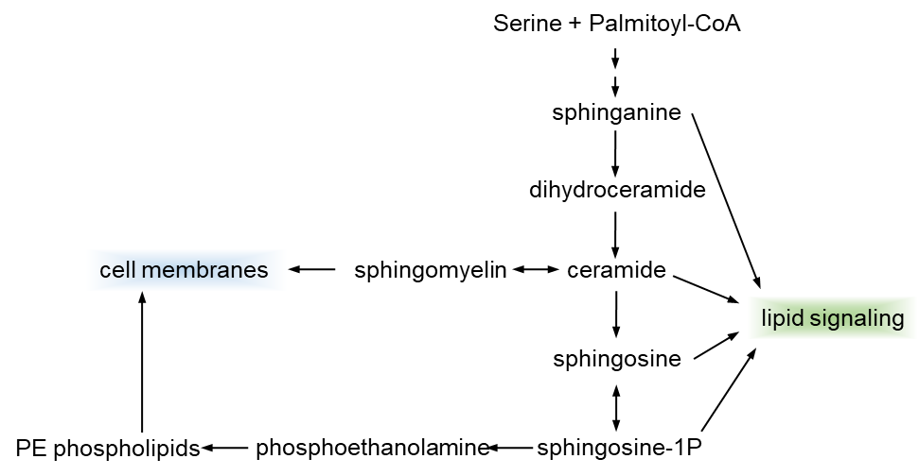
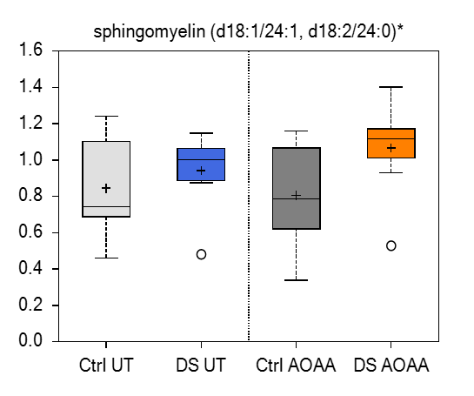
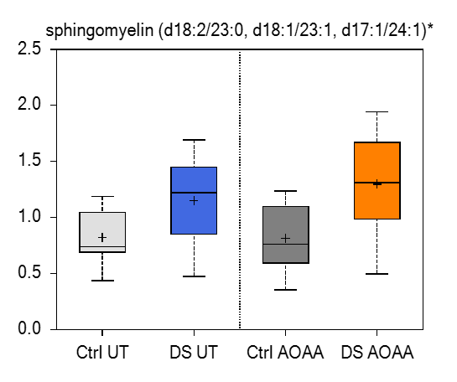
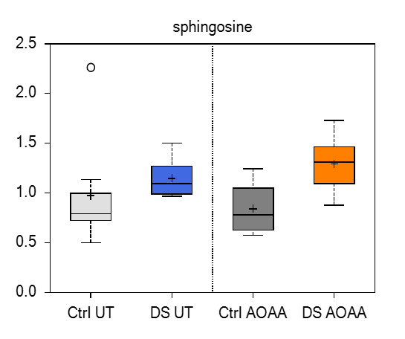
Sphingolipid metabolism

Slide 16




